Slide 1
Sefuda
Gazi Mohib - 011151349 Masrura Akter - 011151200

Slide 2
Description:
Firstly, Sefuda will be appeared and there will be a bottle of juice which he want to drink.
Press ‘t’ to take the bottle
When ‘c’ is pressed then a car will be appeared.
Press ‘u’ to get in the car.
Press ‘s’ to run the car
When ‘d’ is pressed ,he will start to drink and car’s speed is going to increase
Press ‘r’ to stop drinking and car’s speed will be decreased gradually

Slide 3
Individual Task
Masrura Akter
Gazi Mohib
Idea generation & Activities selection
Character design
Character & car implementation
Idea generation & Activities selection
Scenario design
All Logical implementation

Slide 4
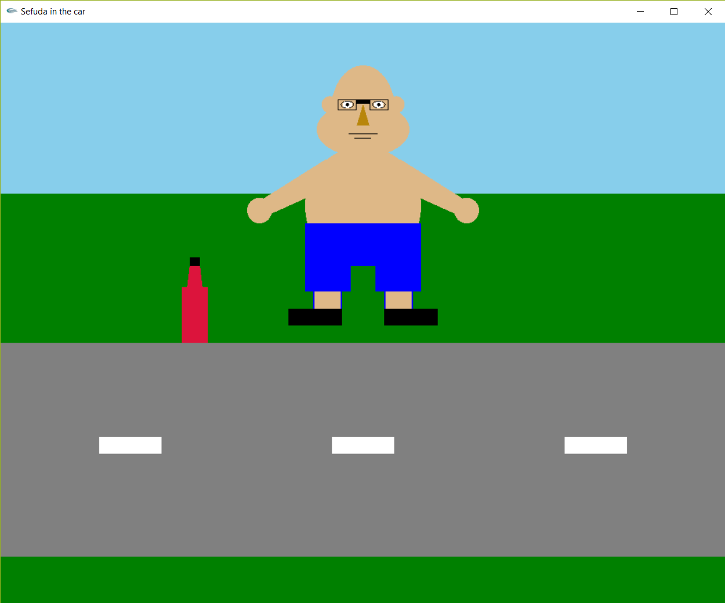
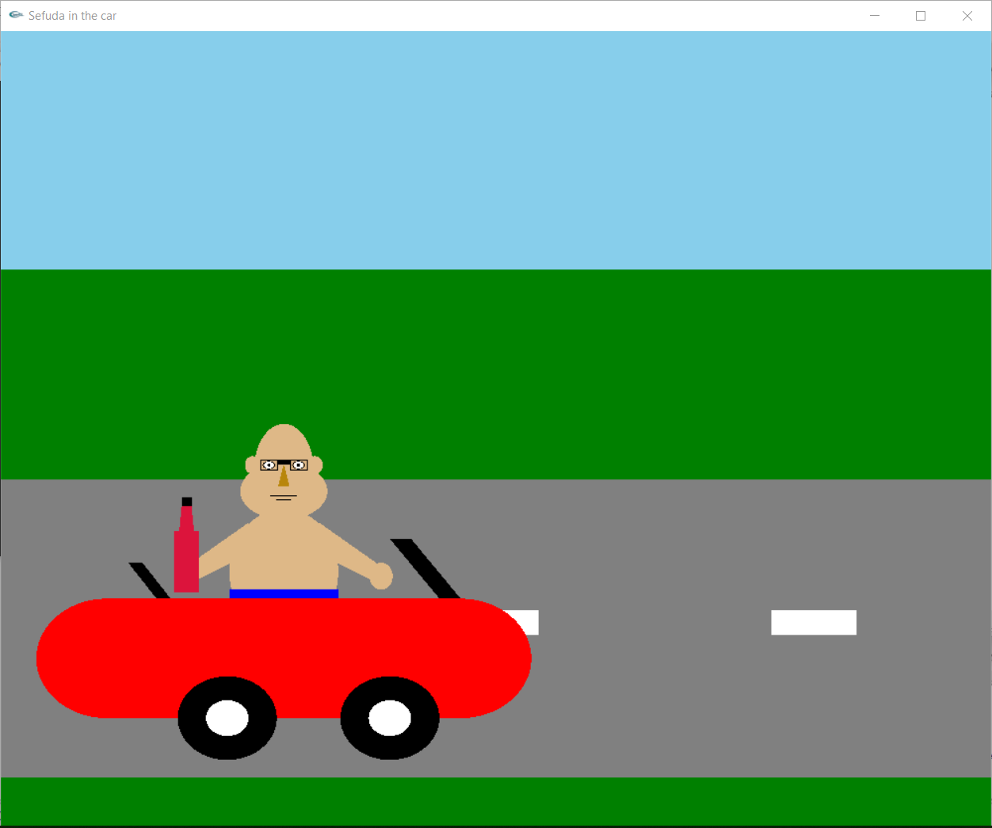

Slide 5


